Slide 1
Emergency Assistance for Livestock, Honeybees and Farm-Raised Fish Program
USDA is an equal opportunity provider, employer, and lender.

Slide 2
Emergency Assistance for Livestock, Honeybees and Farm-Raised Fish Program
The Emergency Assistance for Livestock, Honeybees and Farm-Raised Fish Program (ELAP) provides emergency assist to eligible producers of livestock, honeybees and farm-raised fish.
Notes:
For today, we will be focusing on farm raised fish losses as this is the category that clams and oysters are eligible for under ELAP.

Slide 3
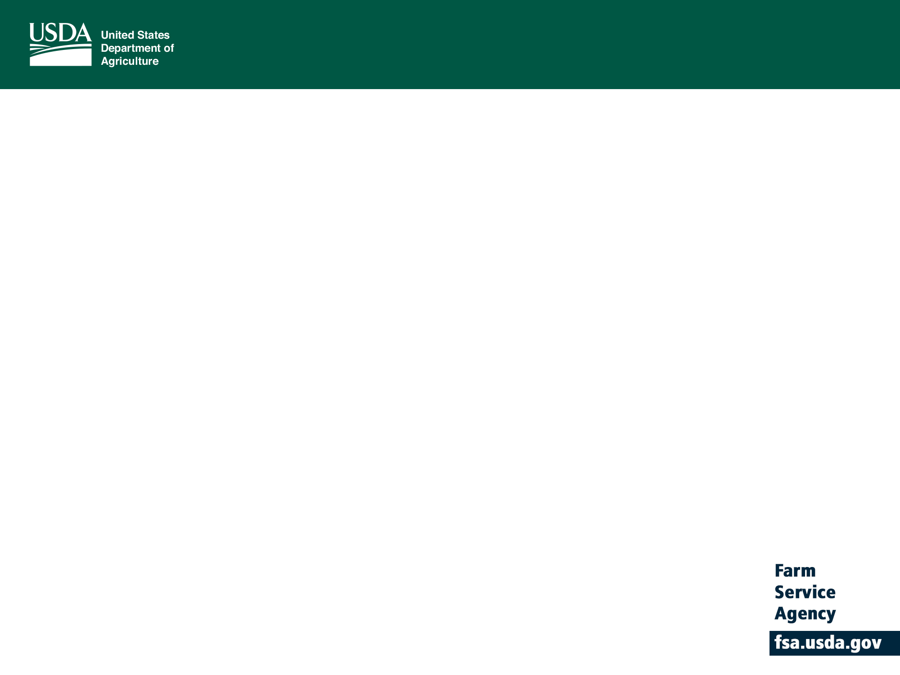
Farm-Raised Fish Assistance
Eligible Producer
An eligible producer is a person or legal entity who, is an owner, operator, landlord, tenant, or sharecropper, who shares in the risk of producing an eligible:
Aquatic species that is propagated and reared in a controlled environment that is being maintained for commercial use as part of the producer’s farming operation; and
Must have:
Owned or leased property with readily identifiable boundaries;
Had control of the waterbed, the ground under the specific type of water and not just control over a column of water; and
Provided purchased or produced feed to the farm-raised fish.

Slide 4
Farm- Raised Fish Assistance
Controlled Environment
Producers must provide evidence that the farm raised fish are being controlled, maintained and harvested according to normal practices. Evidence must prove that the aquatic environment is properly maintained and that potential hazards are being removed.

Slide 5
Farm-Raised Fish Assistance
Eligible Fish
The fish must have been:
Bait or game fish that were propagated and reared in a controlled environment;
Maintained for commercial use as part of a farming operation;
Destroyed as a direct result of an eligible adverse weather or loss condition; and
Physically located in the county where the eligible adverse weather or loss condition occurred on the beginning date of the eligible adverse weather or loss condition.
*Indigenous species are not eligible*

Slide 6
Farm-Raised Fish Assistance
Eligible Losses
Death losses, in excess of normal mortality, of eligible bait fish or game fish caused by an eligible adverse weather or loss condition incurred in the county where the eligible adverse weather or loss condition occurred; and
Purchased or produced farm-raised fish feed losses for feed that was intended to be fed to eligible farm-raised fish and was damaged because of an eligible adverse weather or loss condition in the county where the eligible adverse weather or loss condition occurred.

Slide 7
Farm-Raised Fish Assistance
Eligible Loss Conditions are an eligible adverse weather event in one that is not expected to occur during the loss period for which it occurred, which directly results from or is exacerbated by extreme, abnormal and damaging weather that directly results in farm raised fish losses and include but not limited to:
Excessive heat, Excessive winds, Floods, Hurricane, Tornados, tidal surge, freeze, eligible adverse weather events approved by local County Committee according to FSA handbook 1-ELAP regulations.
Notes:
The loss must be the direct result of an eligible adverse weather or loss condition.

Slide 8
Farm- Raised Fish Assistance
Ineligible Loss Conditions:
Losses due to managerial decisions or losses of species normally incurred in the production cycle, failure of power supply, collapse or failure of equipment and losses due to natural mortality.

Slide 9
Farm-Raised Fish Assistance
Required Documentation
Eligible farm-raised fish producers must provide:
acreage report (surface acres of water) FSA-578- deadline 9/30
verifiable or reliable documentation of:
farm-raised fish death losses due to an eligible loss condition.
inventory on the beginning and ending date of the eligible loss condition.
The aquacultural facility or environment is eligible

Slide 10
Farm-Raised Fish Assistance
Required Documentation for death loss records include but are not limited to:
Acreage reports, loan records, private insurance documents, property tax records, sales and purchase receipts

Slide 11
Farm-Raised Fish Assistance
Required Documentation for beginning and ending inventory records are:
Records that may be verified by COC through an independent source and are used to substantiate the beginning and ending inventory immediately before and after the eligible loss condition. Producers who do not provide acceptable documentation to assist FSA in determining the beginning and ending inventory then those producers will not be eligible to receive ELAP benefits.

Slide 12
Farm-Raised Fish Assistance
Required records to determine the species is produced in an eligible aquaculture facility or environment include:
feeding and fertilization records, hatchery operations, leases, proof of stocking levels, proof that the participant is following best management practices

Slide 13
Producer Records
ELAP requires accurate information from producers. Producers should understand that failure to provide complete and accurate information and records could result in your application being denied, being ineligible for the program for several years, or producer being liable under criminal fraud statue.

Slide 14
ELAP Payment Calculation
Multiply the number of eligible farm-raised fish that died in excess of normal mortality times the average fair market value
Note- The normal mortality rate and fair market value are established by the state committee and mirror NAP.

Slide 15
Payment Calculation Example
Producer A suffered a death loss of 500 fish. STC established an average fair market value of $100/fish and a normal mortality rate of 17%. Producer qualifies as an SDA (Socially Disadvantaged)
100 x 415 (500 fish lost less 85 fish for normal morality) x payment factor of 90% = $37,350 (sequestration rate applied to all payments)

Slide 16
SDA National Payment Factor
For an eligible farm-raised fish producer, payments for farm-raised fish death losses will be based on a national payment factor of either of the following:
• 75 percent of the calculated payment
• 90 percent of the calculated payment, for producers who meet the definition of beginning farmer or rancher, SDA farmer or rancher, or limited resource farmer or rancher, or veteran farmer or rancher.

Slide 17
General Provisions
AGI provisions must be met. Persons or legal entities with certain levels average adjusted gross income that exceeds $900,000 will not be eligible for benefits under ELAP.
There in no payment limitation for ELAP.
Payments will be reduced by the annual sequestration rate.
Notes:
Producers may receive benefits from both NAP and ELAP for eligible losses covered by each program in the same year.

Slide 18
How to Apply
The ELAP program year is based on the calendar year.
Producers must file a notice of loss for farm-raised fish within 30 days of when the loss is first apparent.
Producers must submit an application for payment by January 30th after the end of calendar year in which the loss occurred.
Form CCC-934 is the form to be used for the notice of loss and application for payment.
Form FSA-578 is used for initial acreage report. (deadline 9/30)
Notes:
FSA will use data furnished by the applicant to determine eligibility for program benefits. Furnishing the data is voluntary; however, without all required data, program benefits will not be approved or provided.
Beginning and ending Inventory records are not required at the time you file your notice of loss. Verifiable supporting documentation and inventory records are due by the application for payment deadline of Jan. 30. If you suspect, you have incurred a physical loss please notify your county office and file a notice of loss since there is a 30 day deadline.

Slide 19
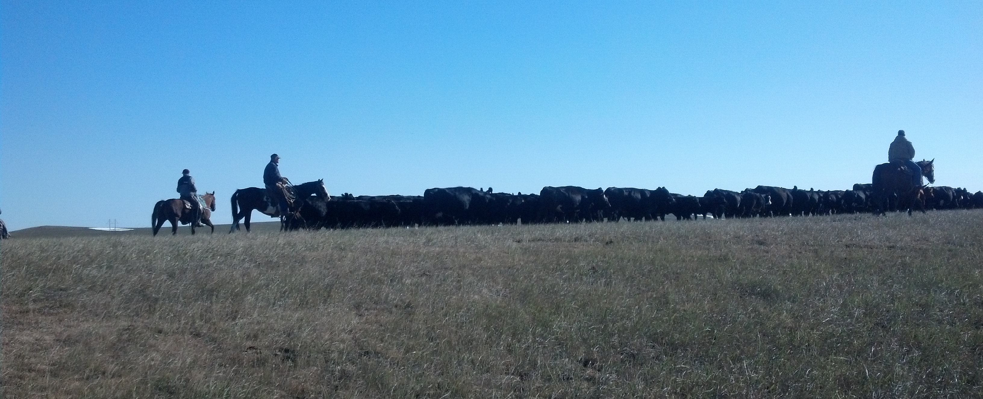
More information on the Emergency Assistance for Livestock, Honeybees and Farm-Raised Fish can be found at:
fsa.usda.gov/disaster

